Slide 1
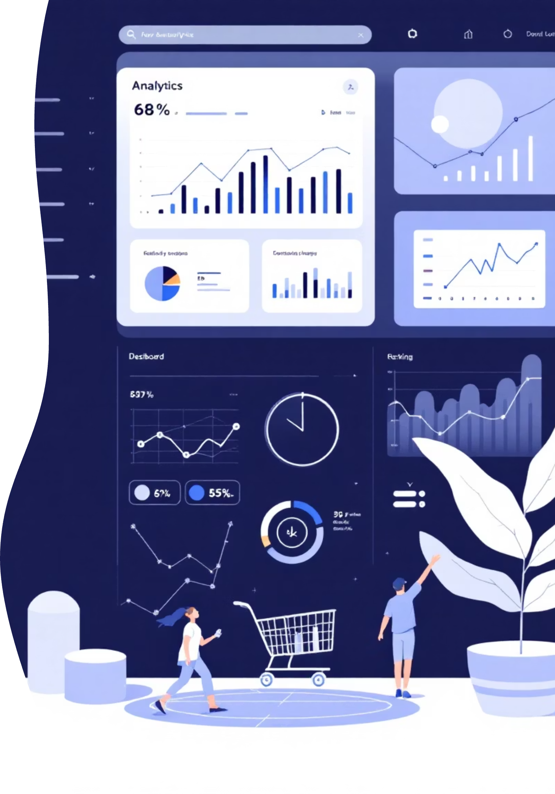
Customer Shopping Behaviour Analysis
Uncovering insights from 3,900 purchases to drive strategic business decisions

Slide 2
DATASET OVERVIEW
The Foundation
3,900
18
37
Total Purchases
Data Columns
Missing Values
Transactions analyzed
Key features tracked
Review ratings imputed
Demographics
Shopping Behavior
Age, Gender, Location
Purchase patterns & frequency
Subscription Status
Discounts, ratings, shipping

Slide 3


PYTHON
Data Preparation & Cleaning
01
Data Loading & Exploration
Imported dataset, checked structure with df.info() and summary statistics
02
Missing Data Handling
Imputed Review Rating nulls using median rating per product category
03
Feature Engineering
Created age_group bins and purchase_frequency_days columns
04
Database Integration
Connected to PostgreSQL and loaded cleaned data for SQL analysis

Slide 4
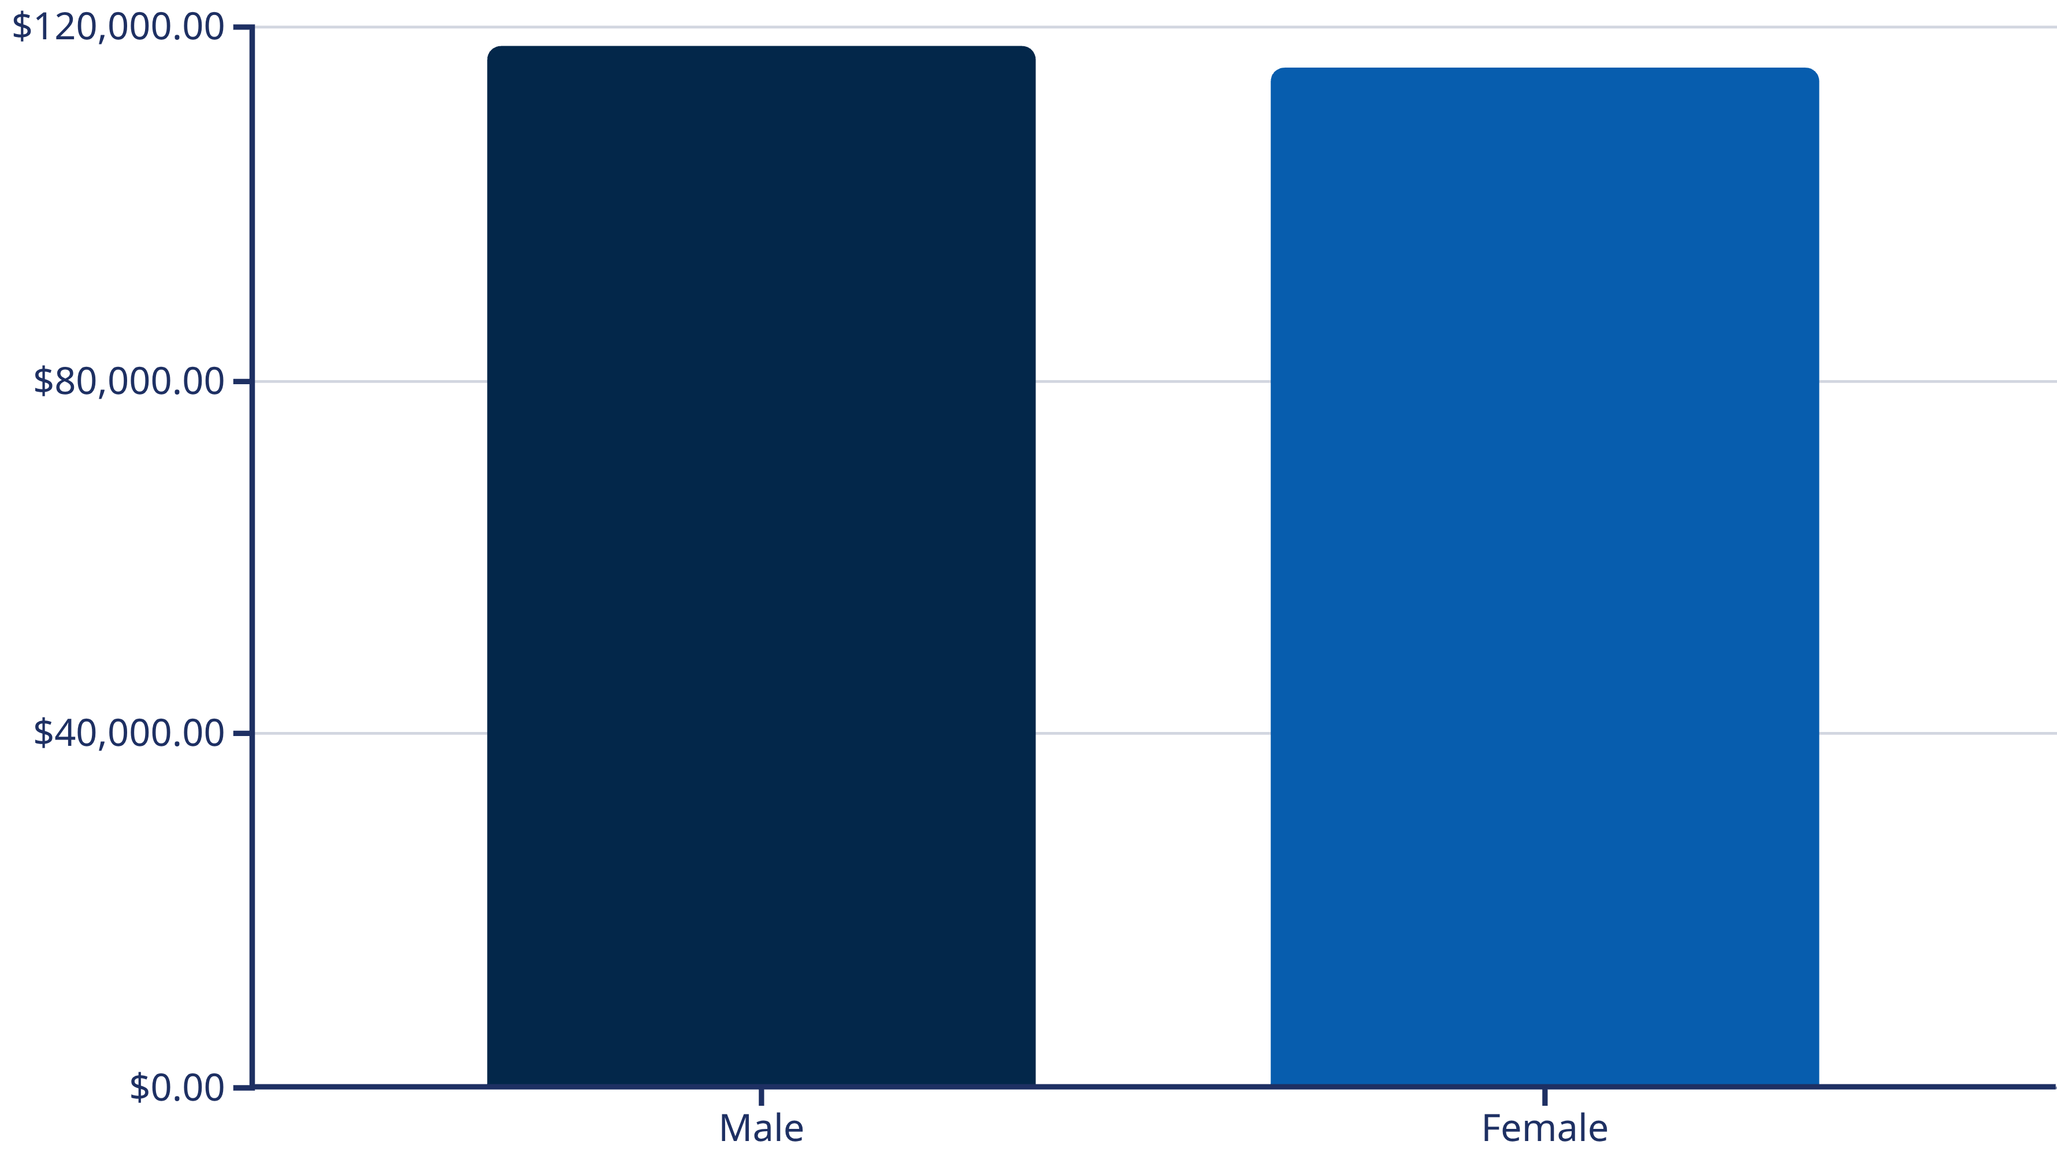
SQL ANALYSIS
Revenue by Gender
Male and female customers contribute nearly equal revenue, indicating balanced market appeal across genders

Slide 5
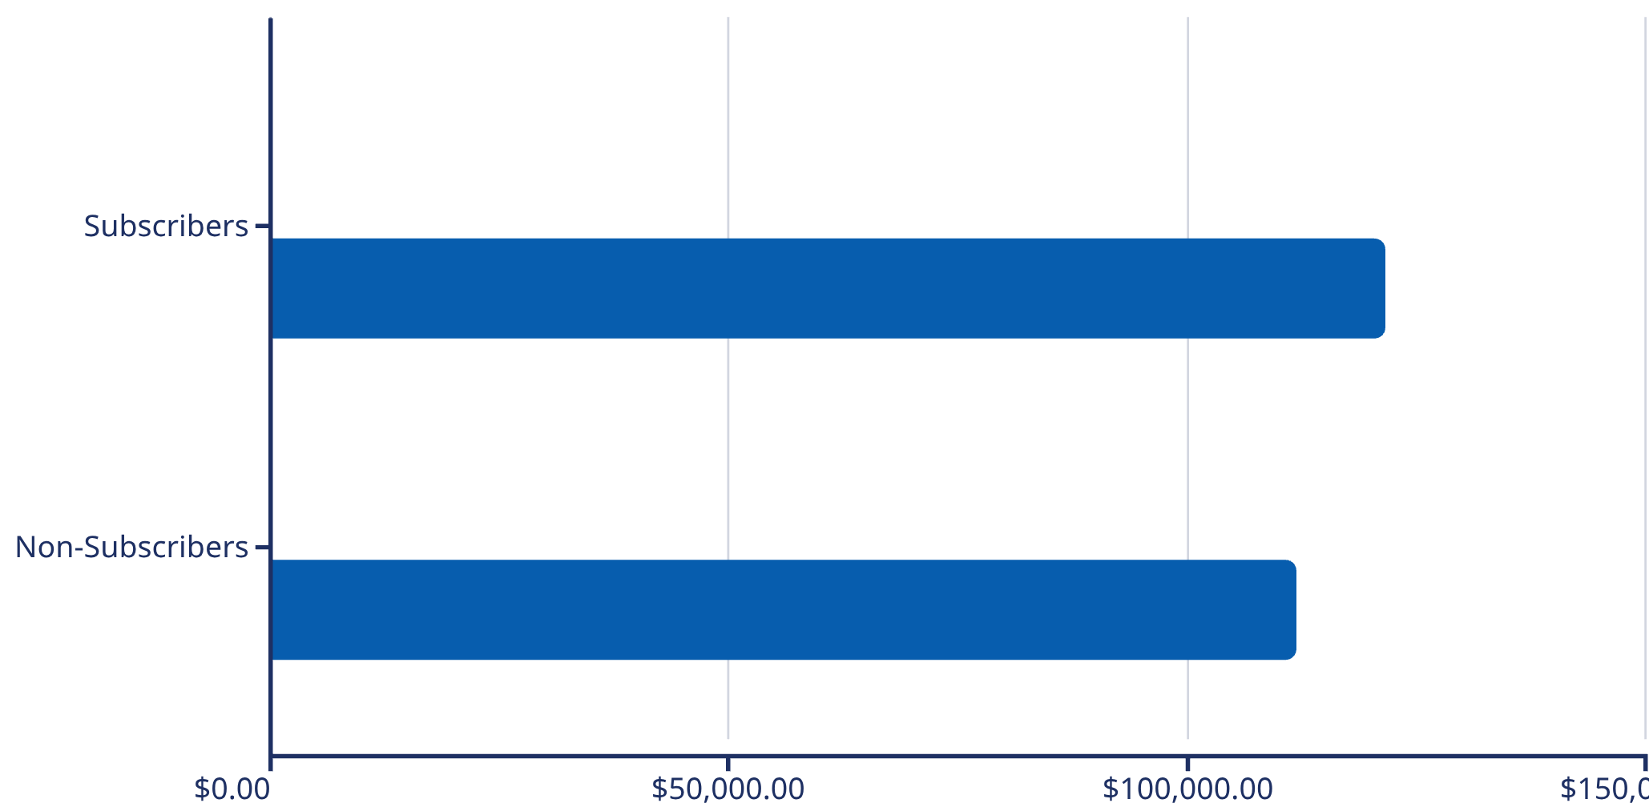

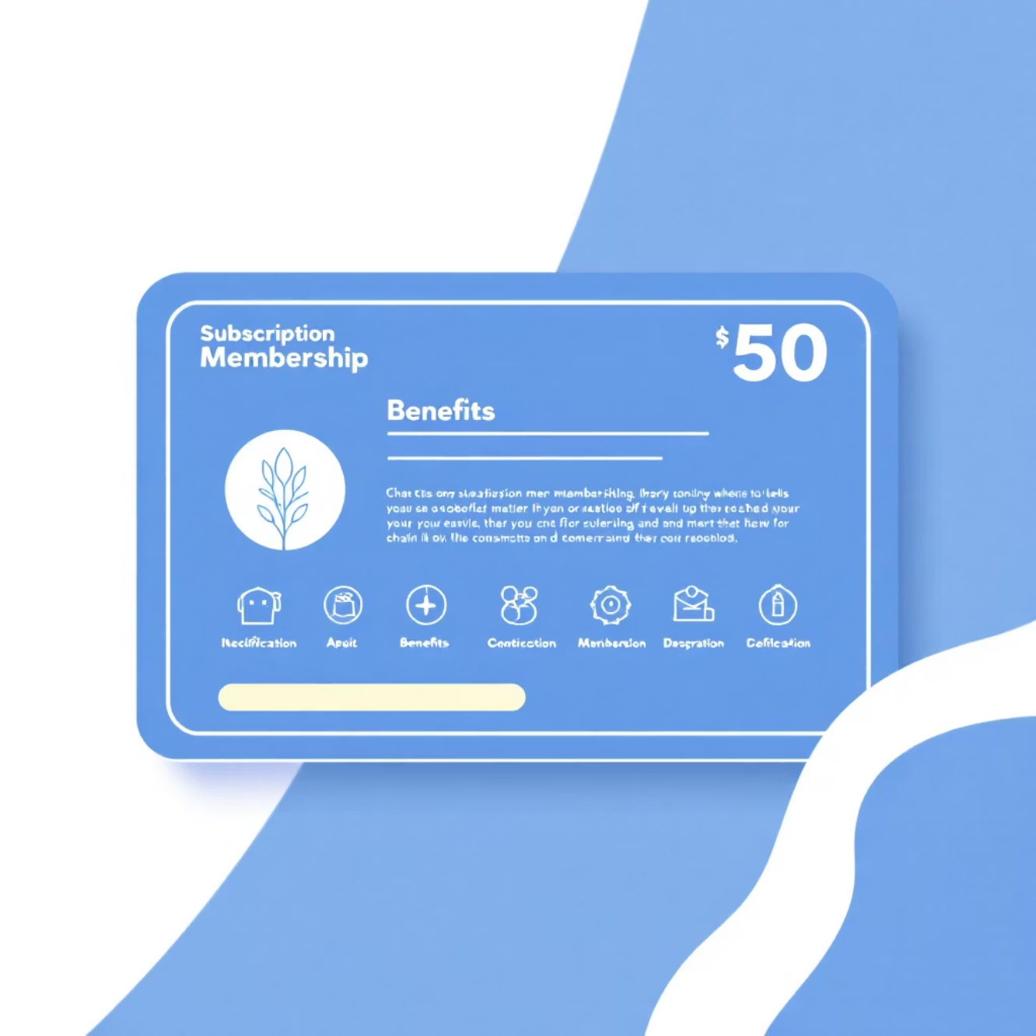
Subscription Impact
Key Insight: Subscribers spend more per transaction and generate higher total revenue
Avg Spend
Total Revenue

Slide 6
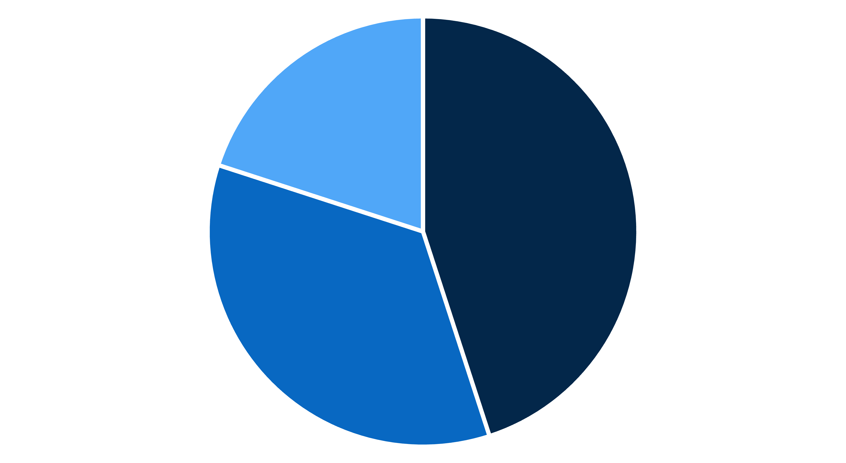
Customer Segmentation
New Customers
Returning Customers
Loyal Customers
1-2 purchases
3-5 purchases
5+ purchases
Building initial relationship
Developing loyalty
High lifetime value
New
Returning
Loyal

Slide 7
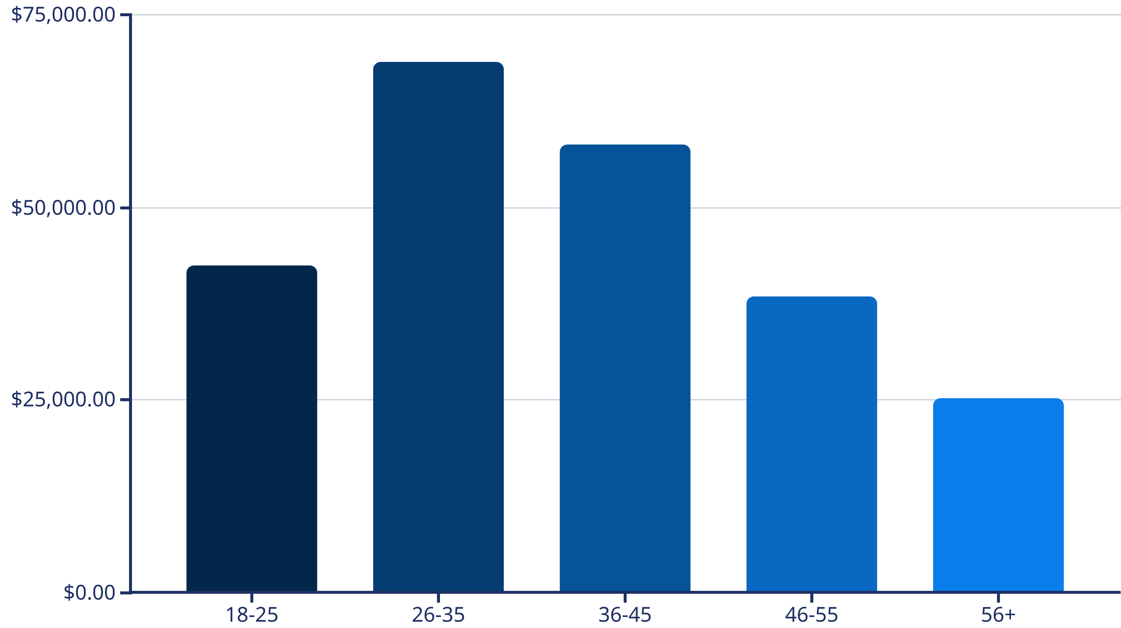
Revenue by Age Group
Ages 26-35 drive highest revenue—prime target for marketing campaigns

Slide 8
Top Performing Locations
1
2
3
Montana
California
Illinois
Highest sales volume
Strong market presence
Growing customer base
4
5
Idaho
Nevada
Emerging opportunity
Consistent performance
Focus campaigns in top-performing cities and ensure popular categories are well-stocked in these regions

Slide 9

POWER BI
Interactive Dashboard
Visual Insights
KPI Tracking
Drill-Down Analysis
Real-time data exploration
Monitor key metrics
Detailed segmentation

Slide 10
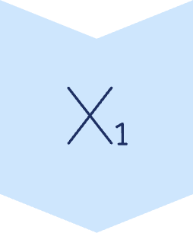




ACTION PLAN
Strategic Recommendations
Boost Subscriptions
Promote exclusive benefits: discounts, faster shipping, loyalty rewards
Loyalty Programs
Design reward systems for repeat buyers—points, cashback, tiered benefits
Review Discount Policy
Balance discounts with profit margins; adjust pricing for discount-dependent products
Product Positioning
Highlight top-rated products in campaigns; leverage reviews to build trust
Targeted Marketing
Focus on high-revenue age groups and express shipping customers; personalize campaigns

